Slide 1
Introduction to Data Structures

Slide 2
Data and information
Data means value or set of values . Data items refers to a single unit of values.
Data is represented in the from of text/numbers/figures/ tables/graphs/pictures etc. A computer Language is incomplete without data.
Information is derived from data, such as:
per capita income, Average Population of the states , price index ,etc.
Data
Method to Process data
I
N
F
O
R
M
A
T
I
O
N

Slide 3
Example of data processed in information
In a month we everyday get the newspaper then at the end we can calculate the bill from the data of the cost of newspaper we daily receive.
Data about some persons in a group:
Distance between the two stations:
A 100 km B
Information Details | Data
Name | Satish
Gender | Male
Age | 32
Phone | 987680987

Slide 4
Examples of data into information
From the score of an individual cricket player we can draw following information:
    Total Runs Scored
    Highest score
    Average
    Strike rate
    No. of Sixes
    No. of fours
This information helps the planners/analysts/to make decisions.
Info. In Computer: A computer is an electronic device that manipulates the information presented in the form of data.
Data: Data is nothing but a collection of numbers, alphabets and symbols combined to represent information.
Entity: An entity possesses some attributes and some values can be allocated to it. E.g. student entity in a college.

Slide 5
Data Structures
Data Structure: Organization of data in computers’ memory so it can be accessed easily to solve the problem
Algorithm: Outline, the essence of a computational procedure, step-by-step instructions
Program: an implementation of an algorithm in some programming language

Slide 6
Classification of Data Structures
Linear: The values are arranged in a linear fashion. E.g. Arrays, Linked Lists, Stacks, Queues etc.
Non-Linear: The values are not arranged in an order. E.g. Tree, Graph, Table etc.
Homogeneous: Here all the values stored are of same type e.g. arrays
Non- Homogeneous: Here all the values stored are of different type e.g. structures and classes.
Dynamic:A dynamic data structure is one that can grow or shrink as needed to contain the data you want stored. That is, you can allocate new storage when it's needed and discard that storage when you're done with it. E.g. pointers, or references
Static:They're essentially fixed-size and often use much space E.g. Array

Slide 7
Classification of Data Structures
Data Structures
Primitive
Data Structures
Non-Primitive
Data Structures
Integer
Real
Character
Boolean
Linear
Data Structures
Non-Linear
Data Structures
Array
Stack
Queue
Linked List
Tree
Graph
Notes:
목차
자바의 생성배경
자바를 사용하는 이유
과거, 현재, 미래의 자바
자바의 발전과정
버전별 JDK에 대한 설명
자바와 C++의 차이점
자바의 성능
자바 관련 산업(?)의 경향

Slide 8
Types of Data Structures
Arrays:
Linear data Structure
All elements stored at contiguous memory locations
Every element is identified by an index (Logical Address)
At the same time every element is identified by a physical address (Physical Address)
We can have 2 D and 3D arrays also but stored in memory in a linear way.

Slide 9
Types of Data Structures
Stack:
  Only the top item can be accessed
  Can only extract one item at a time
A stack is a data structure with the property that only the top element of the stack is accessible
The stack’s storage policy is Last-In, First-Out
Only the top element of a stack is visible, therefore the number of operations performed by a stack are few
Need the ability to
  Inspect the top element
  Retrieve the top element
  Push a new element on the stack
  Test for an empty stack

Slide 10
Types of Data Structures
Queue:
Stores a set of elements in a particular order
Stack principle: FIRST IN FIRST OUT
= FIFO
It means: the first element inserted is the first one to be removed
Real life examples
  Waiting in line
  Waiting on hold for tech support
Applications related to Computer Science
  Threads
  Job scheduling (e.g. Round-Robin algorithm for CPU allocation)

Slide 11
Linked Lists
A
B
C
∅
Head
A linked list is a series of connected nodes
Each node contains at least
  A piece of data (any type)
  Pointer to the next node in the list
Head: pointer to the first node
The last node points to NULL
node
A
data
pointer

Slide 12
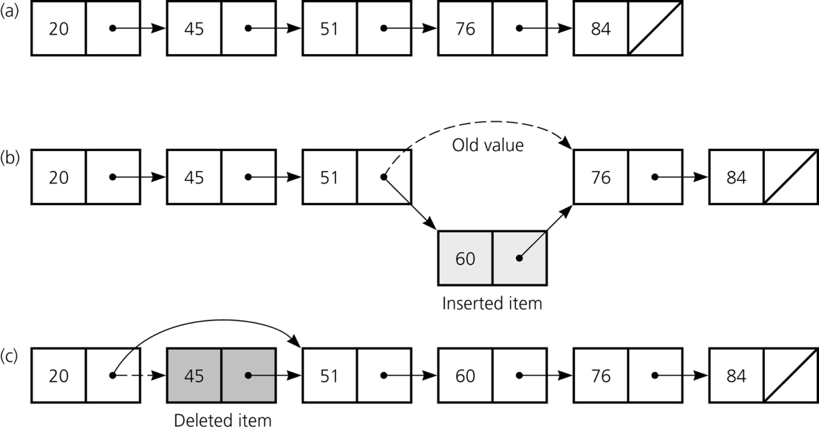
Types of Data Structures
Linked List:
Linear data structure.
Primarily used when the elements are to stored at non-contiguous locations.
  Linked list is able to grow in size as needed.
  Does not require the shifting of items during insertions and deletions.

Slide 13
Terminology for a Tree
Tree: A collection of data whose entries have a hierarchical organization
Node: An entry in a tree
Root node: The node at the top
Terminal or leaf node: A node at the bottom
Parent: The node immediately above a specified node
Child: A node immediately below a specified node
Ancestor: Parent, parent of parent, etc.
Descendent: Child, child of child, etc.
Siblings: Nodes sharing a common parent
Binary tree: A tree in which every node has at most two children
Depth: The number of nodes in longest path from root to leaf

Slide 14
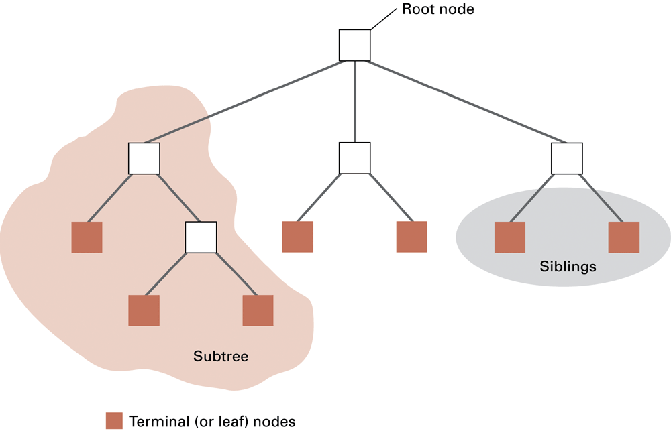
Tree Terminology

Slide 15
Graph
A graph is a pair (V, E), where
  V is a set of nodes, called vertices
  E is a collection of pairs of vertices, called edges
  Vertices and edges are positions and store elements
Example:
  A vertex represents an airport and stores the three-letter airport code
  An edge represents a flight route between two airports and stores the mileage of the route
849
PVD
1843
ORD
142
SFO
802
LGA
337
1743
1387
HNL
2555
1099
LAX
1233
DFW
1120
MIA
Graphs

Slide 16
Edge Types
Directed edge
  ordered pair of vertices (u,v)
  first vertex u is the origin
  second vertex v is the destination
  e.g., a flight
Undirected edge
  unordered pair of vertices (u,v)
  e.g., a flight route
Directed graph
  all the edges are directed
  e.g., route network
Undirected graph
  all the edges are undirected
  e.g., flight network
flight
AA 1206
ORD
PVD
849
miles
ORD
PVD
Graphs

Slide 17
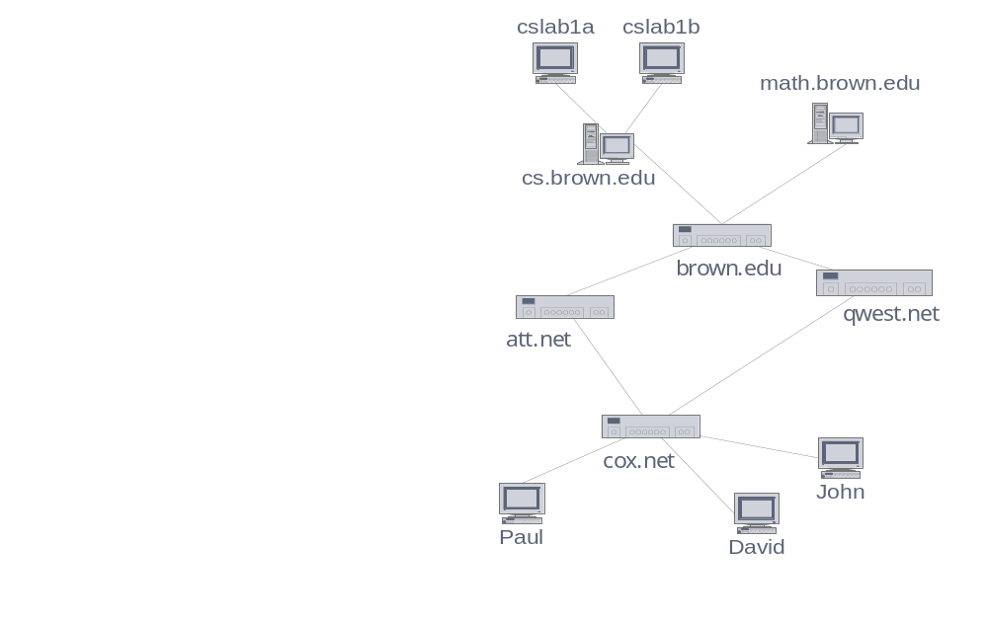
Applications
Electronic circuits
  Printed circuit board
  Integrated circuit
Transportation networks
  Highway network
  Flight network
Computer networks
  Local area network
  Internet
  Web
Databases
  Entity-relationship diagram
Graphs

Slide 18
Data Structure Operations
Data Structures are processed by using certain operations.
Traversing: Accessing each record exactly once so that certain items in the record may be processed.
Searching: Finding the location of the record with a given key value, or finding the location of all the records that satisfy one or more conditions.
Inserting: Adding a new record to the structure.
Deleting: Removing a record from the structure.
Notes:
목차
자바의 생성배경
자바를 사용하는 이유
과거, 현재, 미래의 자바
자바의 발전과정
버전별 JDK에 대한 설명
자바와 C++의 차이점
자바의 성능
자바 관련 산업(?)의 경향

Slide 19
Special Data Structure-Operations
Sorting: Arranging the records in some logical order (Alphabetical or numerical order).
Merging: Combining the records in two different sorted files into a single sorted file.
Notes:
목차
자바의 생성배경
자바를 사용하는 이유
과거, 현재, 미래의 자바
자바의 발전과정
버전별 JDK에 대한 설명
자바와 C++의 차이점
자바의 성능
자바 관련 산업(?)의 경향

Slide 20
Algorithm

Slide 21
Algorithm
Finite step by step list of well-defined instructions for solving a particular problem.
Algorithm is providing a way to access the data from the data structure in most convenient way.
Algorithm is programming independent.
It is written in combination of english language with little syntax conditions.

Slide 22
Algorithm
A clearly specified set of instructions to solve a problem.
Characteristics:
  Input: Zero or more quantities are externally supplied
  Definiteness: Each instruction is clear and unambiguous
  Finiteness: The algorithm terminates in a finite number of steps.
  Effectiveness: Each instruction must be primitive and feasible
  Output: At least one quantity is produced

Slide 23
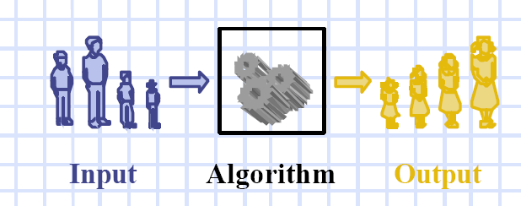
Algorithm

Slide 24
Algorithmic Notations:
Formal presentation of the Algorithm consists of two parts:
A paragraph that tells the purpose of an algorithm. Identifies the variables which occur in the algorithm and lists the input data.
The list of the steps that is to be executed.
Some conventions used in Algorithms:
Identifying Number (Algorithm 2: )
Steps, Control and Exit ( All statements are numbered, Go to and Exit)
Comments (The comments are to be given to understand the meaning)
Variable Names (capital letters are used for variable names)
Assignment Statement (Max:=DATA[1])
Input and output (Read: variable names, Write: Messages and/or variable names)
Procedure

Slide 25
Basic Notations
Control Structures:
Sequential Logic or Sequential Flow
Selection Logic or Conditional Flow
    If (condition) , then:
    -----
    [Endif]
    If (condition) , then:
      -----
      Else :
      -------
      [ Endif]

Slide 26
    Multiple If (condition), then : -----
    Elseif : -----
    Else :
    ------
    [Endif]
3. Iteration Logic (Repetitive Flow)
Repeat step ---- for K=I to N:
[Module] [End of Loop]

Slide 27
While loop
Repeat tep --- while K<= N:
(logic)
[end of while loop]

Slide 28
C++ Program of sum of two numbers
#include<iostream>
Using namespace std;
Main()
{
int a,b,sum;
cout<<“enter a and b”;
cin>> a>>b;
sum=a+b;
cout<<“sum of a and b is “;
cout<<sum;
}
Convert it into algorithm

Slide 29
Sum of N numbers
#include<iostream>
Using namespace std;
Main()
{
int sum=0;
For(int i=0;i<n;i++)
{
cin>>i;
sum=sum +i;
cout<<“sum of n numbers is “;
cout<<sum;
}
Convert it into algorithm

Slide 30
Practice Algorithms
Write an Algorithm (WAA) to find largest of three numbers.
WAA to find the sum of first 10 natural numbers using for loop.
WAA to find the sum of first 10 natural numbers using while loop.

